Slide 1
Hosted Unified Communications
David Byrd
Chief Marketing Officer
January 2014

Slide 2
Company Snapshot
Our Mission | Become the nation’s leading provider of cloud-based unified communications and application solutions to small and medium sized businesses as well as small to mid-size communications providers
Our Solutions | Hosted Unified Communications: Private Label Package End-user solution Innovative widget based portals Automated end-to-end provisioning Cloud based applications (eFax, Call Recording, Storage) Carrier Solutions include Long Distance, Tandem Services and SS7 Connectivity
Our Resources | ≈ 135 employees Operations in Springfield, Illinois, Frisco, Texas and Santa Clara, California Nationwide Network with major switching centers in New York, Atlanta, Chicago, Dallas, Las Vegas, and Los Angeles
Established 1996,
18+ years experience
as service provider
to telephone companies,
wireless service providers and
carriers nationwide
~$123 million revenue
Serve roughly
800 carriers and
independent RLECs
Transport billions of minutes on a private nationwide IP network

Slide 3
Large Untapped Market for IP Telephony
U.S. Market for IP-Based Business Access Lines
 | 12/31/2009 | 6/30/2010 | 12/31/2010 | 6/30/2011 | 12/31/2011
Total U.S. Business Lines | 62,064,000 | 61,417,000 | 61,485,000 | 61,520,000 | 60,525,000
IP Business Lines | 3,574,000 | 3,665,000 | 4,614,000 | 5,019,000 | 5,753,000
IP Telephony Penetration | 5.80% | 6.00% | 7.50% | 8.20% | 9.51%
*Source: FCC Form 477 Filing Data, Local Telephone Competition: Status as of December 31, 2011, dated January 2013

Slide 4

SIP Trunking
Infonetics reported that 43 percent of survey respondents said they are using SIP trunks, adding that adoption of SIP trunking services will drive enterprise SBC market growth five-fold from 2010 to 2015.
58% of businesses will use at least some SIP trunks in 2015 while 55% say they will use will use at least some T-1s. Today 38% using some SIP Trunking and 71% using some T-1s.
Infonetics “, global deployment of SIP Trunking grew by 23 percent in the first half of the year.”
Eastern Management Group “13 percent of businesses use SIP for all of their WAN traffic and forecasts that by 2018, 42 percent of companies will do so.”

Slide 5
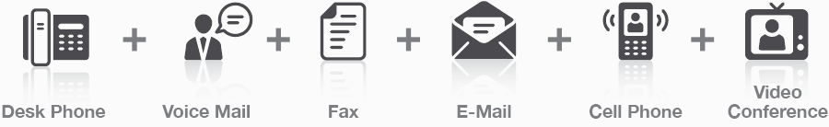
Business Communications Today
Environment: Chaotic, Cost-conscious, Fragmented and Demanding
Multiple communication modalities
Different interfaces and technologies
Lack of integration
Often heavy end-user CapEx, inevitable technological obsolescence

Slide 6














Communications Shift
Application Integration; Improved Management
COMMON MANAGEMENT
User Experience Portals
Enterprise Telephony
eMail and Instant Messaging
Overall
Costs
Down
Choice beyond Voice
Audio Conference
Horizontally integrated common platform
  Standards-based distributed architecture
  Accessibility in the entire network
  One common database
SEPARATE MANAGEMENT
Video Conference
eMail & Integration
IM and Presence
Enterprise Telephony
Web Conference
Colloboration
Voicemail
Vertically aligned communication silos
  Inefficient communications
  Communications overload
  Parallel infrastructures
Notes:
6

Slide 7
Hosted Unified Communications

Slide 8
Hosted Unified Communications
Benefits
Increase Productivity
Enable Mobility
Increase Collaboration
Achieve Business Continuity
Eliminate/Reduce Capital Expenditures
Avoid Technology Obsolescence

Slide 9
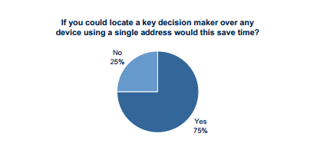
Increase Productivity
Hosted Unified Communications
Communication bottle necks occur when:
  One cannot locate key party to solve issue
  One cannot coordinate meeting to resolve problem
  Information is difficult to find and access
  One receives no response to important email messages

Slide 10
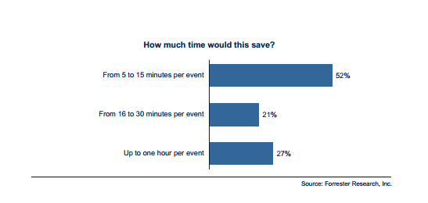
Increase Productivity
Hosted Unified Communications
With Integrated Messaging
  Reach the right people quickly
  Contact using a single number
  Establish ad hoc audio, web and video conferences
  Leverage mobile devices

Slide 11

Increase Mobility
Hosted Unified Communications
The lack of UC capabilities for remote workers results in a substantial “productivity gap” between mobile/offsite and onsite workers which results in a productivity loss of 2.5 hours per week per employee
Approximately 18% of projects are delayed because of ineffective team collaboration and an estimated 16% of projects are delayed because a decision maker could not be reached
Enterprise workers listed “Sharing Files” and “Participating in a Multimedia Conference” as the two most “painful” tasks to perform when working offsite

Slide 12

Increase Mobility
Hosted Unified Communications
43% of business owners use a cell phone as their primary communications platform
Smartphones now make up 61% of cell phone users
Only 20% of Smartphone usage is for making phone calls
Smartphones are used as the primary device for online access by 50% of users
Integrated Mobility
Mobile Client
Chat
Presence
Desktop Sharing
Call Handling
Audio/Web/Video Collaboration
Outlook Integration

Slide 13

Increase Collaboration
Hosted Unified Communications
Chadwick Martin Bailey
54% of organizations saved up to 20 minutes per employee daily by escalating IM chats into phone calls.
50% of organizations saved up to 20 minutes per employee daily by escalating IM chats into Web conferences
46% of organizations realized travel savings of more than five days per employee annually.
68% of organizations reported productivity improvements between geographically-dispersed functional groups.
Over 75% percent of organizations experienced improved productivity of employees across geographically-dispersed locations due to voice and video conferencing.
64% of organizations experienced reduced travel costs of over 10%.

Slide 14
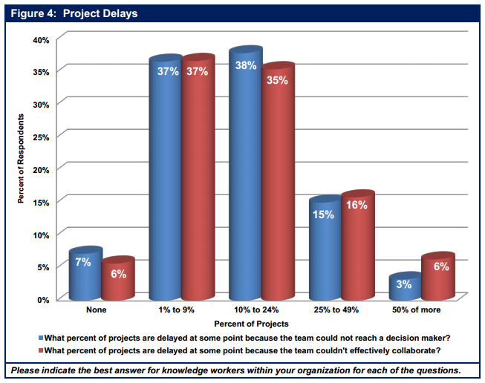
Increase Collaboration
Hosted Unified Communications

Slide 15

Increase Collaboration
Hosted Unified Communications
Collaboration
  Audio Conferencing
  Web Meeting
  Video Conferencing
  Desktop Sharing
Mobile Client
Chat
Presence
Call Handling
Outlook Integration

Slide 16

Achieve Business Continuity
Hosted Unified Communications
50% of SMBs admit to not having Business Continuity or Disaster Recovery plans in place
16% believe there is no business requirement to have such a plan
Only 28% have an actual plan in place

Slide 17

Achieve Business Continuity
Hosted Unified Communications
“A Company that experiences a computer outage lasting more than 10 days will never fully recover financially. 50% will be out of business within five years.” — Jon Toiga, Disaster Recovery Planning: Managing Risk and Catastrophe in Information Systems
70% of small firms that experience a major data loss go out of business within a year. —Strategic Research Corp and DTI/PWC
43% of Businesses that experience a disaster and have no emergency plan never reopen; of those that do reopen, only 29 percent are still operating two years later. —The Hartford Financial Services Group

Slide 18
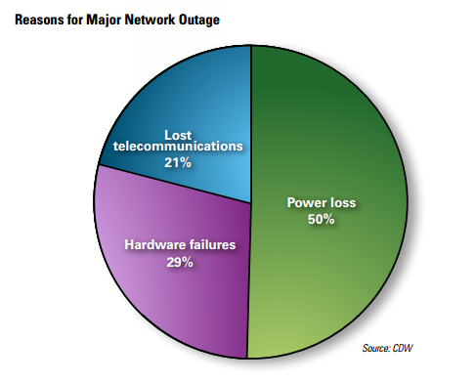
Achieve Business Continuity
Hosted Unified Communications
Ninety-seven percent of those surveyed said the network disruptions had "detrimental effects" on business productivity.
46% said employees could not access the necessary company resources to do their jobs during an outage.
Of the 200 respondents who had a significant outage in the past year, 34% said they are moving to update business continuity and disaster recovery capabilities. – CDW

Slide 19
Achieve Business Continuity
Hosted Unified Communications
ABI Research forecasts that the global market for business continuity and disaster data recovery solutions will grow from $24.3 billion in 2009 to exceed $39 billion in 2015
Hosted Unified Communications supports Business Continuity by:
Redundant servers
Geographically dispersed servers
Alternate routing of calls (call forwarding, simultaneous ring, find me/follow me, etc.
Alternate call devices (IP Phone, Smartphone, Laptop, Tablet)

Slide 20

Eliminate/Reduce Capital Expenditures
Hosted Unified Communications
$25,000 on-premises collaboration and audio conferencing solution may be difficult to get approved, however, a hosted solution for less than $400 per month can initiate a powerful internal conversation.
By moving to hosted , Companies were able to reduce their 3-year TCO by 54%. – IDC
IT maintenance is around 80% of total IT expenditure, thus the shift to hosted. – Gartner
Hosted can make the difference between an organization being 20% efficient and being 80% efficient. – Diversity Limited

Slide 21
Eliminate/Reduce Capital Expenditures
Hosted Unified Communications
Need new infrastructure
Cloud services are quick to deploy
Rent versus purchase the solution
Acquire Future Proof technology vs non-returnable licenses and ongoing maintenance fees
Scale IT up and down easily adjust business in accordance to economic environment
Don’t believe that you have to spend money to make money

Slide 22

Eliminate/Reduce Capital Expenditures
Hosted Unified Communications
No Equipment Cost
Phones can be purchased (CAPEX) or leased (OPEX)
No annual maintenance fees
Fixed monthly usage fees
Scale your service as your business grows or shrinks
Add or delete services on a per user basis

Slide 23

Technology Obsolescence
Hosted Unified Communications
The average lifespan for a handset in the US is 21.7 months. – Recon Analytics
Average server life span is 3 years – Computer World
Average laptop life span is 2.5 years.
New IP PBXs are forecasted to last only 6.5 years, while traditional PBXs could be counted on for 8.5 or more years.
One study respondent indicated that they had to replace their PBX after only three years “ because the upgrade cost was almost equal to the original capital expenditure.
23

Slide 24
Prevent Technology Obsolescence
Hosted Unified Communications
Hosted communications allows businesses to leverage:
Other application buyers to reduce acquisition cost
Advances to the hosted application are spread across all users
Upgraded Servers to maintain SLA committed performance without changes to monthly charges
New features are made available to subscribers on a regular basis

Slide 25
Hosted Unified Communications
Increase Productivity
Enable Mobility
Increase Collaboration
Achieve Business Continuity
Eliminate/Reduce Capital Expenditures
Avoid Technology Obsolescence
Now You know the Rest of the Story!

Slide 26
www.anpi.com
David Byrd
dbyrd@anpi.com
214.377.0944

